Slide 1
Week # 5 & 6
Stacks and Queues
Data Structure

Slide 2
In this chapter we’ll examine three data storage structures: the stack, the queue, and the priority queue. We’ll begin by discussing how these structures differ from arrays; then we’ll examine each one in turn. In the last section, we’ll
look at an operation in which the stack plays a significant role: parsing arithmetic expressions

Slide 3
Stacks
  To understand the idea of a stack, consider an email, msg inbox.
An item is inserted or removed from the stack from one end called the “top” of the stack.
This mechanism is called Last-In-First-Out (LIFO).
  Items are removed from a stack in the reverse order from the way they were inserted
  Some of the applications that use Stack are :
  microprocessors,
  Parser of Compiler
  some older calculators etc.

Slide 4
What is the difference?
Stack & Queue vs. Array
  Arrays are data storage structures that might find in a database
  application, they’re typically used for personnel records,
  inventories, financial data, and so on, while stacks and queues are specialized DS and used as programmer’s tools. Their lifetime is typically shorter than that of the database-type structures.
RestrictedAccess
In an array, any item can be accessed, either immediately—if its index number is known—or by searching through a sequence of cells until it’s found. In the data structures in this chapter, however, access is restricted: Only one item can be read or removed at a given time (unless you cheat).
More Abstract
Stacks, queues, and priority queues are more abstract entities than arrays and many other data storage structures. They’re defined primarily by their interface: the permissible operations that can be carried out on them. The underlying mechanism used to
implement them is typically not visible to their user

Slide 5
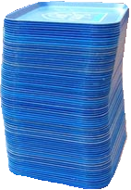
Stack operations
Placing a data item on the top is called “pushing”, while removing an item from the top is called “popping” it, and examine the top element is called peek
Push and pop are the two primary stack operations. However, it’s sometimes useful to be able to read the value from the top of the stack without removing it. The peek operation does this.
push
pop, peek
top | 3
 | 2
bottom | 1
stack

Slide 6
Stacks
Adding an
element
Removing
an element
Top of stack
1-<number>

Slide 7
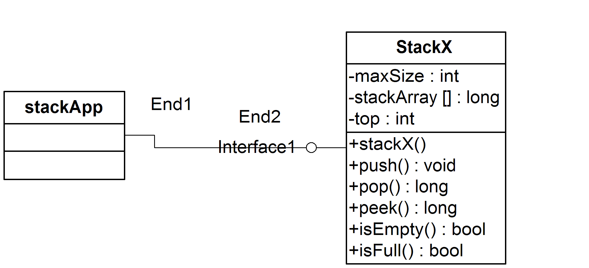
Example of Stack codes
First example stack ADT and implementation
push and pop operations are performed in O(1) time.

Slide 8
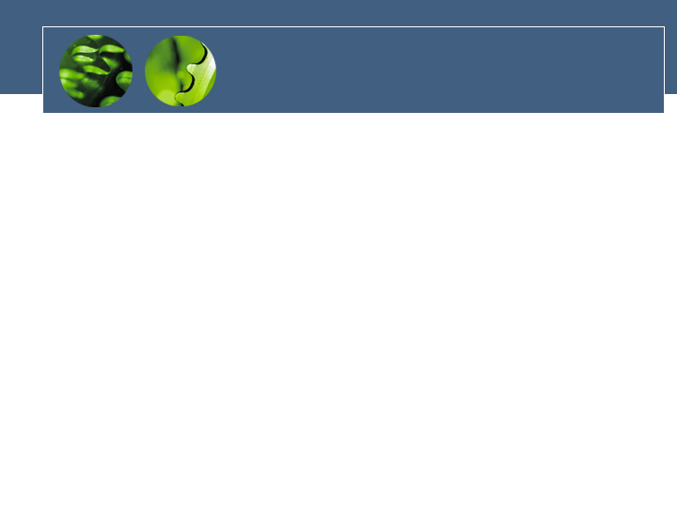
Error checking
There are two stack errors that can occur:
  Underflow: trying to pop (or peek at) an empty stack
  Overflow: trying to push onto an already full stack
if( !theStack.isFull() )
insert(item);
else
System.out.print(“Can’t insert, stack is full”);
For overflow, you could do the same things
public boolean isEmpty() // true if stack is empty
{
return (top == -1);
}

Slide 9
Example of Stack codes
Reversed word
What is it?
ABC -> CBA
See example at the book

Slide 10
Efficiency of Stacks
Items can be both pushed and popped in constant O(1) time.
The time is not dependent on how many items are in the stack, and is therefore very quick.
No comparisons or moves are necessary

Slide 11
Stack Implementation
Stack implementation is listed in figure 4.1 page 120 at the textbook
Stack Example 1: Reversing a Word page 124

Slide 12
Class Stack
  Stack<String> s = new Stack<String>();
  s.push("a");
  s.push("b");
  s.push("c"); // bottom ["a", "b", "c"] top
  System.out.println(s.pop()); // "c"
Stack<E>() | constructs a new stack with elements of type E
push(value) | places given value on top of stack
pop() | removes top value from stack and returns it; throws EmptyStackException if stack is empty
peek() | returns top value from stack without removing it; throws EmptyStackException if stack is empty
size() | returns number of elements in stack
isEmpty() | returns true if stack has no elements

Slide 13
Using a Stack to Evaluate a Postfix Expression
Given the expression: 7* 4 * -3 1 + 5 /
+
*
5
/
1
6
*
-3
-2
-12
4
top
7
-14
1-<number>

Slide 14
Queues
Of course, many people don’t rigorously follow this top-to-bottom approach. They may, for example, take the mail off the bottom of the stack, so as to process the oldest letter first. Or they might shuffle through the mail before they begin processing it and put higher-priority letters on top. In these cases, their mail system is no longer a stack in the computer-science sense of the word. If they take letters off the bottom, it’s a queue; and if they prioritize it, it’s a priority queue.

Slide 15
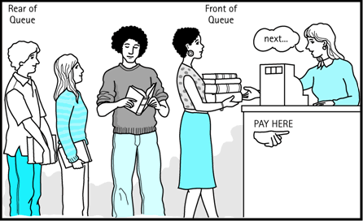
Queues
Queue is an ADT data structure similar to stack, except that the first item to be inserted is the first one to be removed.
This mechanism is called First-In-First-Out (FIFO).
Placing an item in a queue is called “insertion or enqueue”, which is done at the end of the queue called “rear”.
Removing an item from a queue is called “deletion or dequeue”, which is done at the other end of the queue called “front”.
Elements are removed from the queue in the same order in which they are placed on the queue

Slide 16
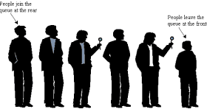
Implementing Queue
Some of the applications are : printer queue, keystroke queue, buying ticket queue etc.
A queue is consistent with the general concept of a waiting line
Queue can be implemented using an Array, Stack or Linked List. The easiest way of implementing a queue is by using an Array. Initially the head(FRONT) and the tail(REAR) of the queue points at the first index of the array (starting the index of array from 0). As we add elements to the queue, the tail keeps on moving ahead, always pointing to the position where the next element will be inserted, while the head remains at the first index ( see next slide)

Slide 17
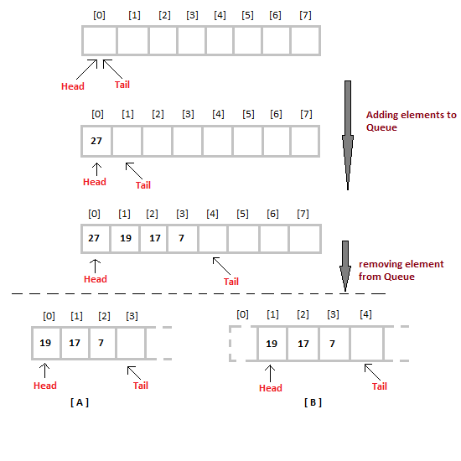
When we remove an element from Queue, we can follow two possible approaches (mentioned [A] and [B] in above diagram). In approach [A], we remove the element at head position, and then one by one shift all the other elements in forward position. In approach [B], we remove the element from head position and then move head to the next position.
In approach [A], there is an overhead of shifting the elements one position forward every time we remove the first element. In approach [B] there is no such overhead, but whenever we move head one position ahead, after removal of first element, the size on Queue is reduced by one space each time

Slide 18
Queues
Adding an
element
Removing
an element
rear of queue
front of queue
1-<number>

Slide 19
Algorithm for the tow operations
Algorithm for ENQUEUE operation
Check if the queue is full or not.
If the queue is full, then print overflow error and exit the program.
If the queue is not full, then increment the tail and add the element.
Algorithm for DEQUEUE operation
Check if the queue is empty or not.
If the queue is empty, then print underflow error and exit the program.
If the queue is not empty, then print the element at the head and increment the head

Slide 20
Queues in computer science
Operating systems:
  - queue of print jobs to send to the printer
  - queue of programs / processes to be run
  - queue of network data packets to send
Programming:
  - modeling a line of customers or clients
  - storing a queue of computations to be performed in order
Real world examples:
  - people on an escalator or waiting in a line
  - cars at a gas station (or on an assembly line)

Slide 21
Programming with Queues
add(value) | places given value at back of queue
remove() | removes value from front of queue and returns it; throws a NoSuchElementException if queue is empty
peek() | returns front value from queue without removing it; returns null if queue is empty
size() | returns number of elements in queue
isEmpty() | returns true if queue has no elements

Slide 22
2- Circular Queue
When a new item is inserted at the rear, the pointer to rear moves upwards.
Similarly, when an item is deleted from the queue the front arrow moves downwards.
After a few insert and delete operations the rear might reach the end of the queue and no more items can be inserted although the items from the front of the queue have been deleted and there is space in the queue.

Slide 23
Circular Queue
To solve this problem, queues implement wrapping around. Such queues are called Circular Queues.
Both the front and the rear pointers wrap around to the beginning of the array.
It is also called as “Ring buffer”.
Items can inserted and deleted from a queue in O(1) time.

Slide 24
Implementing Queues with Circular Arrays
n
0
n-1
1
2
A
3
front
3
4
4
B
…
5
rear
7
6
…
6
count
4
8
7
C
3
D
1-<number>

Slide 25
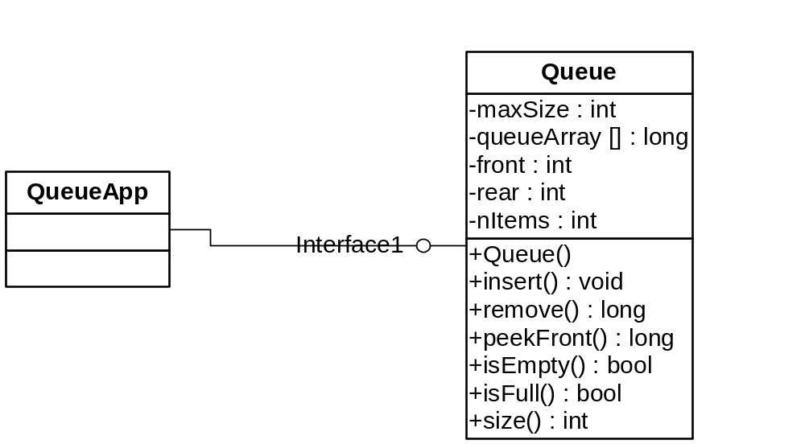
Basic Operations

Slide 26
Various Queues Types
Normal queue (FIFO)
Circular Queue (Normal Queue)
Double-ended Queue (Deque)
Priority Queue

Slide 27
Deque
It is a double-ended queue.
Items can be inserted and deleted from either ends.
More versatile data structure than stack or queue.
In real scenario we can attached it to a Ticket purchasing line, It performs like a queue but some time It happens that some body has purchased the ticket and sudden they come back to ask some thing on front of queue. In this scenario because they have already purchased the ticket so they have privilege to come and ask for any further query

Slide 28
Priority Queues
More specialized data structure.
Similar to Queue, having front and rear.
Items are removed from the front.
Items are ordered by key value so that the item with the lowest key (or highest) is always at the front.
Items are inserted in proper position to maintain the order.
E.g. policy-based application (e.g. low priority go to the end, high go to the front), used in multi tasking operating system.
In a case where you want to sort the queue once in a while, What sorting algorithm will you use?
Insertion runs in O(n) time, deletion in O(1) time.

Slide 29
Queue implementation is listed in figure 4.4 page 108 at the textbook
Implementing the priority listing in figure 4.6 page 115.

